Slide 1
Global Framework for Climate Services Process: Filipe Lucio DRR Exemplar: Maxx Dilley (on behalf of UNISDR, UNDP, World bank,, WMO, IFRC team) DRR Compendium and Link to This Activity: Maryam Golnaraghi
www.wmo.int/gfcs

Slide 2
Process for the development of the Implementation Plan
http://www.wmo.int/pages/gfcs/ip_en.php
Notes:
The development of the Implementation Plan involved more than 300 experts who participated in the consultations and experts nominated by Governments, Un Agencies, Regional Organizations and from various communities of practices.
As the drafts of the implementation Plan were developed, they were shared with experts and publicly made available for the review of stakeholders.

Slide 3
Notes:
Next steps
Establishment of Inter-Agency Coordination Group (WHO, FAO, UN-ISDR, UNESCO, UNDP, WFP, WB)
Develop effective forms of cooperation between organizations of the UN system engaged in the GFCS in the planning and implementation of the initiative across UN partner organizations
Establishment of a GFCS Oversight Board
Provide oversight for the completion of the Exemplars, development of the Compendium of GFCS Projects, support preparation of the meeting of the Intergovernmental Board
Launch pilot projects

Slide 4
Disaster reduction “Exemplar”
Contributors:
International Federation of Red Cross/Crescent Societies
International Strategy for Disaster Reduction Secretariat
World Bank Global Framework for Disaster Risk Reduction and Recovery
World Meteorological Organization
United Nations Development Programme
Notes:
There could be various definition of climate services. Under the GFCS, the are understood as the process for generating and providing information on past, present and future climate , and on the impacts on natural and human systems. They can comprise historical climate date sets, climate monitoring, climate watches, Monthly/Seasonal/Decadal climate predictions, and climate change projections.
They involve interaction with users with a view to help them in accessing the right product for decision making and using appropriately the information and services including aspects of language, probabilities and uncertainty.

Slide 5
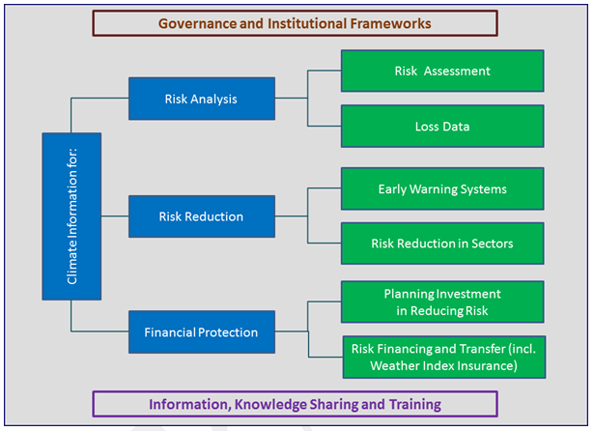
Disaster reduction components
Notes:
The GFCS aims to advance global collaboration through multidisciplinary partnerships, improved governance, climate observations, monitoring, research and prediction.
We will continue strengthening the dialogue between users and providers of climate services, across boundaries.
Together with capacity-building and exchange of experiences, these partnerships will ensure greater availability of, access to, and use of climate services for all countries and in particular enable the most vulnerable to limit the impact of, or adapt to, climate change and variability.
Climate issues concern us all and have no borders.
Individual nations, national meteorological and hydrological services and other relevant partners are increasingly coming together to develop and deliver regional climate services.
Regional outlooks and predictions are a good example.

Slide 6
Disaster reduction GFCS requirements
 | UIP | CSIS | Obs/Mon | RMP | Capacity development
Risk assessment
Loss data
Early warning
Risk reduction in sectors
Planning investment
Risk finance and transfer
Capacity development
Requirements
Notes:
The GFCS aims to advance global collaboration through multidisciplinary partnerships, improved governance, climate observations, monitoring, research and prediction.
We will continue strengthening the dialogue between users and providers of climate services, across boundaries.
Together with capacity-building and exchange of experiences, these partnerships will ensure greater availability of, access to, and use of climate services for all countries and in particular enable the most vulnerable to limit the impact of, or adapt to, climate change and variability.
Climate issues concern us all and have no borders.
Individual nations, national meteorological and hydrological services and other relevant partners are increasingly coming together to develop and deliver regional climate services.
Regional outlooks and predictions are a good example.

Slide 7
Disaster reduction proposed initial support
High climate-risk countries receive enhanced disaster risk reduction support through improved climate information and services
Enhanced DRR-related climate information and services are provided for initiatives on disaster risk analysis, risk reduction and financial protection
Enhanced climate services for DRR are promoted through facilitation, basic training and capacity development, advocacy and outreach
Notes:
There could be various definition of climate services. Under the GFCS, the are understood as the process for generating and providing information on past, present and future climate , and on the impacts on natural and human systems. They can comprise historical climate date sets, climate monitoring, climate watches, Monthly/Seasonal/Decadal climate predictions, and climate change projections.
They involve interaction with users with a view to help them in accessing the right product for decision making and using appropriately the information and services including aspects of language, probabilities and uncertainty.

Slide 8
Extract from DRR GFCS Compendium
Enhanced DRR-related climate information and services are provided for initiatives on disaster risk analysis, risk reduction and financial protection.
DRR-related products and services that can benefit from the GFCS Pillars are identified in the DRR Exemplar. A number of multi-agency initiatives to develop these products and services are already underway. Specific activities under this objective will:
Enhance the standards, methodologies, guidelines and training materials generated by several planned multi-stakeholder initiatives focused on risk analysis through GFCS engagement. These initiatives focus on standardization of extreme event characterization, risk assessment and risk profiling at country level, and country-level implementation of databases that track disaster losses (loss data).

Slide 9
Thank you for your attention
www.wmo.int/gfcs

